Slide 1
CNN Acceleration

Slide 2
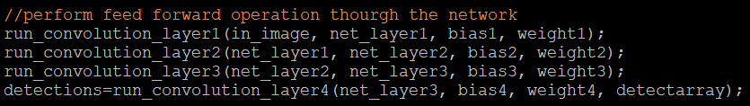
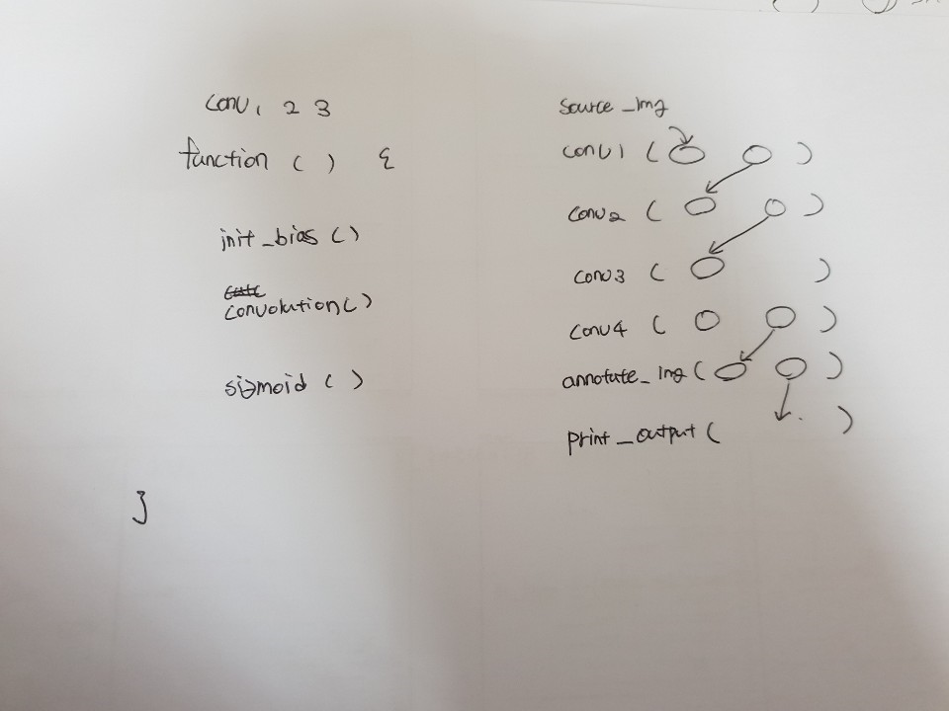
CNN Acceleration
CNN Functions

Slide 3
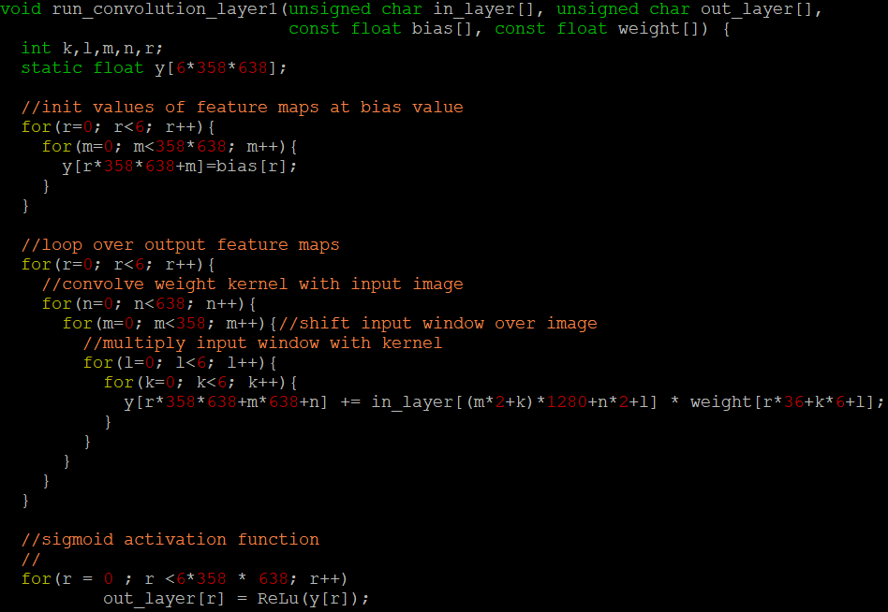
CNN Acceleration
Using Pure C– Layer_1

Slide 4
Using Data- Convolution_layer1
Data | Size
in_layer ( Input_image) | 720 * 1280
filter | 6 * 6
Padding | 0
Stride | 2
Number of filter ( = Nof) | 6
weight | filtersize(36) * Nof
y (feature map) | Nof * 358 * 638

Slide 5
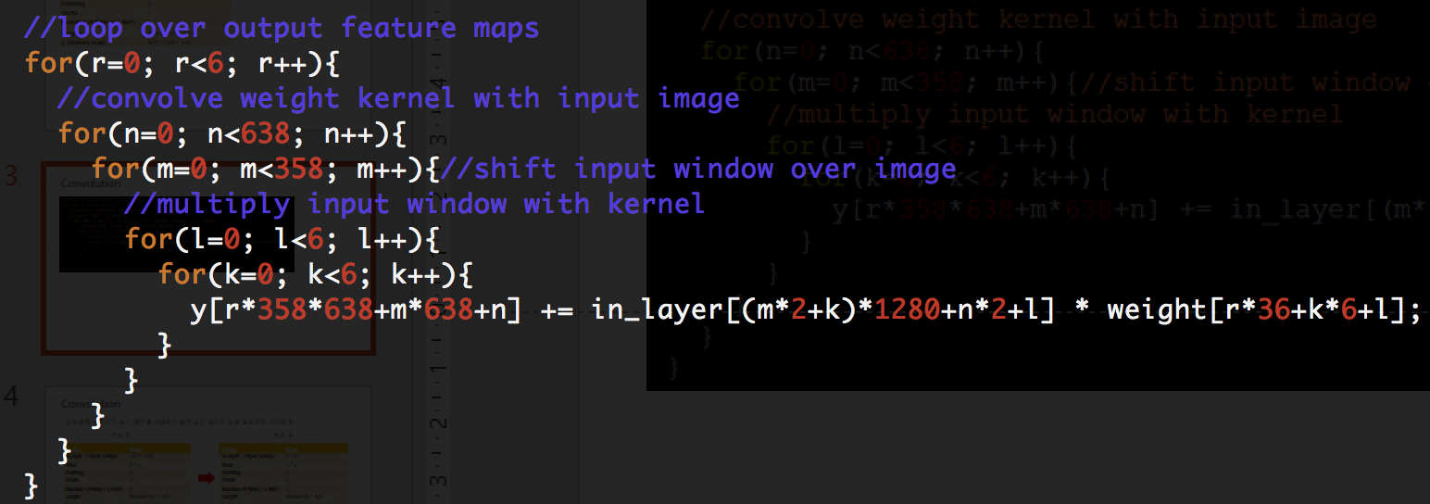
Convolution

Slide 6
Convolution
입력,출력 이미지가 크기 때문에 이해하기 쉽게 모든 데이터 값을 축소하여 시각화 함.
변경 전
변경 후
Data | Size
in_layer ( Input_image) | 720 * 1280
filter | 6 * 6
Padding | 0
Stride | 2
Number of filter ( = Nof) | 6
weight | filtersize(36) * Nof
y (feature map) | Nof * 358 * 638
Data | Size
in_layer ( Input_image) | 6 * 8
filter | 2 * 2
Padding | 0
Stride | 2
Number of filter ( = Nof) | 3
weight | filtersize(4) * Nof
y (feature map) | Nof * 3 * 4

Slide 7
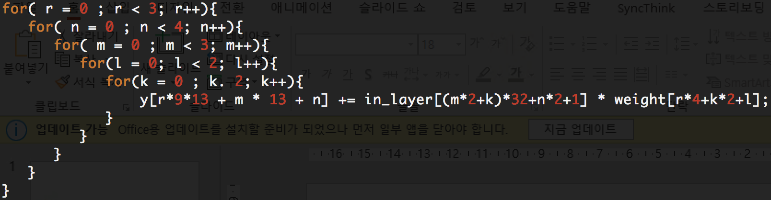
Convolution
각 데이터에 맞게 코드 변경.

Slide 8
Convolution
in_layer
r=0 , n=0 , m=0 , l=0, k=0
0 | 1 | 2 | 3 | 4 | 5 | 6 | 7
8 | 9 | 10 | 11 | 12 | 13 | 14 | 15
16 | 17 | 18 | 19 | 20 | 21 | 22 | 23
24 | 25 | 26 | 27 | 28 | 29 | 30 | 31
32 | 33 | 34 | 35 | 36 | 37 | 38 | 39
40 | 41 | 42 | 43 | 44 | 45 | 46 | 47
weight
y [ 0 ] = += in_layer[0] * weight[0]
0 | 1 | 2 | 3
4 | 5 | 6 | 7
8 | 9 | 10 | 11
X
r=0 , n=0 , m=0 , l=0, k=1
in_layer
y [ 0 ] = += in_layer[8] * weight[2]
0 | 1 | 2 | 3 | 4 | 5 | 6 | 7
8 | 9 | 10 | 11 | 12 | 13 | 14 | 15
16 | 17 | 18 | 19 | 20 | 21 | 22 | 23
24 | 25 | 26 | 27 | 28 | 29 | 30 | 31
32 | 33 | 34 | 35 | 36 | 37 | 38 | 39
40 | 41 | 42 | 43 | 44 | 45 | 46 | 47
weight
0 | 1 | 2 | 3
4 | 5 | 6 | 7
8 | 9 | 10 | 11
X

Slide 9
Convolution
in_layer
r=0 , n=0 , m=0 , l=1, k=0
0 | 1 | 2 | 3 | 4 | 5 | 6 | 7
8 | 9 | 10 | 11 | 12 | 13 | 14 | 15
16 | 17 | 18 | 19 | 20 | 21 | 22 | 23
24 | 25 | 26 | 27 | 28 | 29 | 30 | 31
32 | 33 | 34 | 35 | 36 | 37 | 38 | 39
40 | 41 | 42 | 43 | 44 | 45 | 46 | 47
weight
y [ 0 ] = += in_layer[1] * weight[1]
0 | 1 | 2 | 3
4 | 5 | 6 | 7
8 | 9 | 10 | 11
X
r=0 , n=0 , m=0 , l=1, k=1
in_layer
y [ 0 ] = += in_layer[9] * weight[3]
0 | 1 | 2 | 3 | 4 | 5 | 6 | 7
8 | 9 | 10 | 11 | 12 | 13 | 14 | 15
16 | 17 | 18 | 19 | 20 | 21 | 22 | 23
24 | 25 | 26 | 27 | 28 | 29 | 30 | 31
32 | 33 | 34 | 35 | 36 | 37 | 38 | 39
40 | 41 | 42 | 43 | 44 | 45 | 46 | 47
weight
0 | 1 | 2 | 3
4 | 5 | 6 | 7
8 | 9 | 10 | 11
X

Slide 10
Convolution
in_layer
0 | 1 | 2 | 3 | 4 | 5 | 6 | 7
8 | 9 | 10 | 11 | 12 | 13 | 14 | 15
16 | 17 | 18 | 19 | 20 | 21 | 22 | 23
24 | 25 | 26 | 27 | 28 | 29 | 30 | 31
32 | 33 | 34 | 35 | 36 | 37 | 38 | 39
40 | 41 | 42 | 43 | 44 | 45 | 46 | 47
weight
fm1
fm2
fm3
0 | 1 | 2 | 3 | 4 | 5 | 6 | 7 | 8 | 9 | 10 | 11
12 | 13 | 14 | 15 | 16 | 17 | 18 | 19 | 20 | 21 | 22 | 23
24 | 25 | 26 | 27 | 28 | 29 | 30 | 31 | 32 | 33 | 34 | 35
+=
0 | 1 | 2 | 3
4 | 5 | 6 | 7
8 | 9 | 10 | 11
X
fm1
0 | 1 | 2 | 3
4 | 5 | 6 | 7
8 | 9 | 10 | 11
in_layer[0] * weight[0]
in_layer[8] * weight[2]
in_layer[1] * weight[1]
in_layer[9] * weight[3]

Slide 11
Convolution
in_layer
r=0 , n=0 , m=1 , l=0, k=0
0 | 1 | 2 | 3 | 4 | 5 | 6 | 7
8 | 9 | 10 | 11 | 12 | 13 | 14 | 15
16 | 17 | 18 | 19 | 20 | 21 | 22 | 23
24 | 25 | 26 | 27 | 28 | 29 | 30 | 31
32 | 33 | 34 | 35 | 36 | 37 | 38 | 39
40 | 41 | 42 | 43 | 44 | 45 | 46 | 47
weight
y [ 4 ] = += in_layer[16] * weight[0]
0 | 1 | 2 | 3
4 | 5 | 6 | 7
8 | 9 | 10 | 11
X
r=0 , n=0 , m=1 , l=0, k=1
in_layer
y [ 4 ] = += in_layer[24] * weight[2]
0 | 1 | 2 | 3 | 4 | 5 | 6 | 7
8 | 9 | 10 | 11 | 12 | 13 | 14 | 15
16 | 17 | 18 | 19 | 20 | 21 | 22 | 23
24 | 25 | 26 | 27 | 28 | 29 | 30 | 31
32 | 33 | 34 | 35 | 36 | 37 | 38 | 39
40 | 41 | 42 | 43 | 44 | 45 | 46 | 47
weight
0 | 1 | 2 | 3
4 | 5 | 6 | 7
8 | 9 | 10 | 11
X

Slide 12
Convolution
in_layer
r=0 , n=0 , m=1 , l=1, k=0
0 | 1 | 2 | 3 | 4 | 5 | 6 | 7
8 | 9 | 10 | 11 | 12 | 13 | 14 | 15
16 | 17 | 18 | 19 | 20 | 21 | 22 | 23
24 | 25 | 26 | 27 | 28 | 29 | 30 | 31
32 | 33 | 34 | 35 | 36 | 37 | 38 | 39
40 | 41 | 42 | 43 | 44 | 45 | 46 | 47
weight
y [ 4 ] = += in_layer[17] * weight[1]
0 | 1 | 2 | 3
4 | 5 | 6 | 7
8 | 9 | 10 | 11
X
r=0 , n=0 , m=1 , l=1, k=1
in_layer
y [ 4 ] = += in_layer[25] * weight[3]
0 | 1 | 2 | 3 | 4 | 5 | 6 | 7
8 | 9 | 10 | 11 | 12 | 13 | 14 | 15
16 | 17 | 18 | 19 | 20 | 21 | 22 | 23
24 | 25 | 26 | 27 | 28 | 29 | 30 | 31
32 | 33 | 34 | 35 | 36 | 37 | 38 | 39
40 | 41 | 42 | 43 | 44 | 45 | 46 | 47
weight
0 | 1 | 2 | 3
4 | 5 | 6 | 7
8 | 9 | 10 | 11
X

Slide 13
Convolution
in_layer
0 | 1 | 2 | 3 | 4 | 5 | 6 | 7
8 | 9 | 10 | 11 | 12 | 13 | 14 | 15
16 | 17 | 18 | 19 | 20 | 21 | 22 | 23
24 | 25 | 26 | 27 | 28 | 29 | 30 | 31
32 | 33 | 34 | 35 | 36 | 37 | 38 | 39
40 | 41 | 42 | 43 | 44 | 45 | 46 | 47
weight
fm1
fm2
fm3
0 | 1 | 2 | 3 | 4 | 5 | 6 | 7 | 8 | 9 | 10 | 11
12 | 13 | 14 | 15 | 16 | 17 | 18 | 19 | 20 | 21 | 22 | 23
24 | 25 | 26 | 27 | 28 | 29 | 30 | 31 | 32 | 33 | 34 | 35
+=
0 | 1 | 2 | 3
4 | 5 | 6 | 7
8 | 9 | 10 | 11
X
fm1
0 | 1 | 2 | 3
4 | 5 | 6 | 7
8 | 9 | 10 | 11
in_layer[16] * weight[0]
in_layer[24] * weight[2]
in_layer[17] * weight[1]
in_layer[25] * weight[3]

Slide 14
Convolution
in_layer
r=0 , n=1 , m=0 , l=0, k=0
0 | 1 | 2 | 3 | 4 | 5 | 6 | 7
8 | 9 | 10 | 11 | 12 | 13 | 14 | 15
16 | 17 | 18 | 19 | 20 | 21 | 22 | 23
24 | 25 | 26 | 27 | 28 | 29 | 30 | 31
32 | 33 | 34 | 35 | 36 | 37 | 38 | 39
40 | 41 | 42 | 43 | 44 | 45 | 46 | 47
weight
y [ 1 ] = += in_layer[2] * weight[0]
0 | 1 | 2 | 3
4 | 5 | 6 | 7
8 | 9 | 10 | 11
X
r=0 , n=1 , m=1 , l=0, k=1
in_layer
y [ 1 ] = += in_layer[10] * weight[2]
0 | 1 | 2 | 3 | 4 | 5 | 6 | 7
8 | 9 | 10 | 11 | 12 | 13 | 14 | 15
16 | 17 | 18 | 19 | 20 | 21 | 22 | 23
24 | 25 | 26 | 27 | 28 | 29 | 30 | 31
32 | 33 | 34 | 35 | 36 | 37 | 38 | 39
40 | 41 | 42 | 43 | 44 | 45 | 46 | 47
weight
0 | 1 | 2 | 3
4 | 5 | 6 | 7
8 | 9 | 10 | 11
X

Slide 15
Convolution
in_layer
r=0 , n=1 , m=0 , l=1, k=0
0 | 1 | 2 | 3 | 4 | 5 | 6 | 7
8 | 9 | 10 | 11 | 12 | 13 | 14 | 15
16 | 17 | 18 | 19 | 20 | 21 | 22 | 23
24 | 25 | 26 | 27 | 28 | 29 | 30 | 31
32 | 33 | 34 | 35 | 36 | 37 | 38 | 39
40 | 41 | 42 | 43 | 44 | 45 | 46 | 47
weight
y [ 1 ] = += in_layer[3] * weight[1]
0 | 1 | 2 | 3
4 | 5 | 6 | 7
8 | 9 | 10 | 11
X
r=0 , n=1 , m=0 , l=1, k=1
in_layer
y [ 4 ] = += in_layer[11] * weight[3]
0 | 1 | 2 | 3 | 4 | 5 | 6 | 7
8 | 9 | 10 | 11 | 12 | 13 | 14 | 15
16 | 17 | 18 | 19 | 20 | 21 | 22 | 23
24 | 25 | 26 | 27 | 28 | 29 | 30 | 31
32 | 33 | 34 | 35 | 36 | 37 | 38 | 39
40 | 41 | 42 | 43 | 44 | 45 | 46 | 47
weight
0 | 1 | 2 | 3
4 | 5 | 6 | 7
8 | 9 | 10 | 11
X

Slide 16
Convolution
in_layer
0 | 1 | 2 | 3 | 4 | 5 | 6 | 7
8 | 9 | 10 | 11 | 12 | 13 | 14 | 15
16 | 17 | 18 | 19 | 20 | 21 | 22 | 23
24 | 25 | 26 | 27 | 28 | 29 | 30 | 31
32 | 33 | 34 | 35 | 36 | 37 | 38 | 39
40 | 41 | 42 | 43 | 44 | 45 | 46 | 47
weight
fm1
fm2
fm3
0 | 1 | 2 | 3 | 4 | 5 | 6 | 7 | 8 | 9 | 10 | 11
12 | 13 | 14 | 15 | 16 | 17 | 18 | 19 | 20 | 21 | 22 | 23
24 | 25 | 26 | 27 | 28 | 29 | 30 | 31 | 32 | 33 | 34 | 35
+=
0 | 1 | 2 | 3
4 | 5 | 6 | 7
8 | 9 | 10 | 11
X
fm1
0 | 1 | 2 | 3
4 | 5 | 6 | 7
8 | 9 | 10 | 11
in_layer[2] * weight[0]
in_layer[3] * weight[2]
in_layer[10] * weight[1]
in_layer[11] * weight[3]

Slide 17
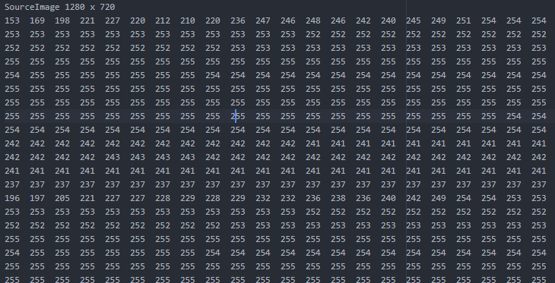
CNN Acceleration
Using Pure C– Layer_1

Slide 18

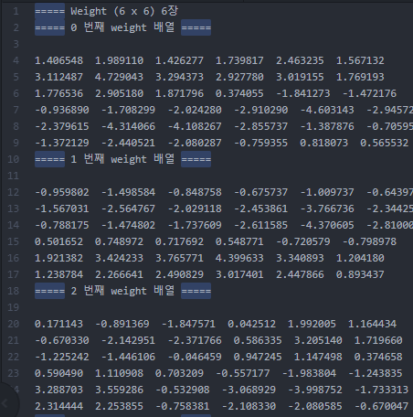
CNN Acceleration
Using Pure C– Layer_1

Slide 19
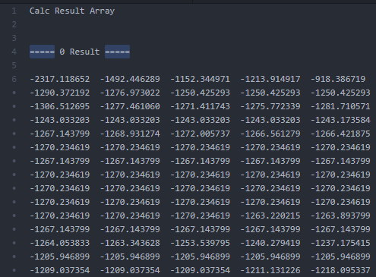
CNN Acceleration
Using Pure C– Layer_1

Slide 20
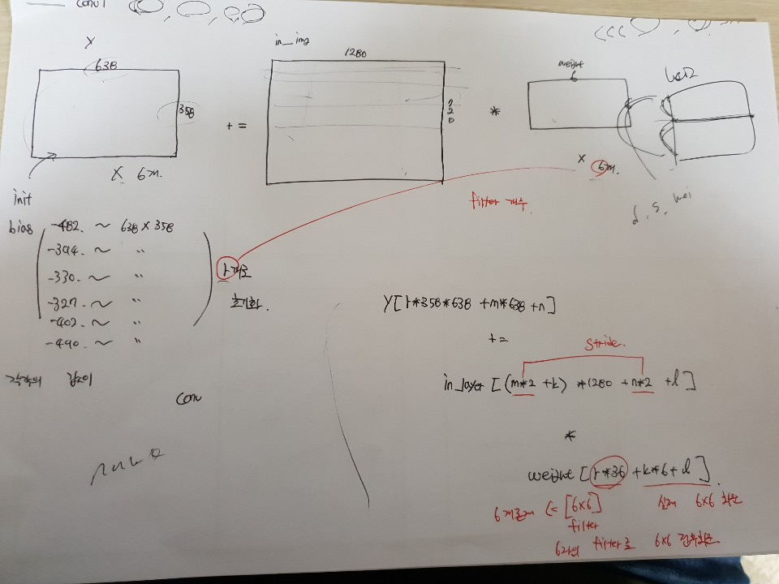
CNN Acceleration
Using Pure C– Layer_1

Slide 21
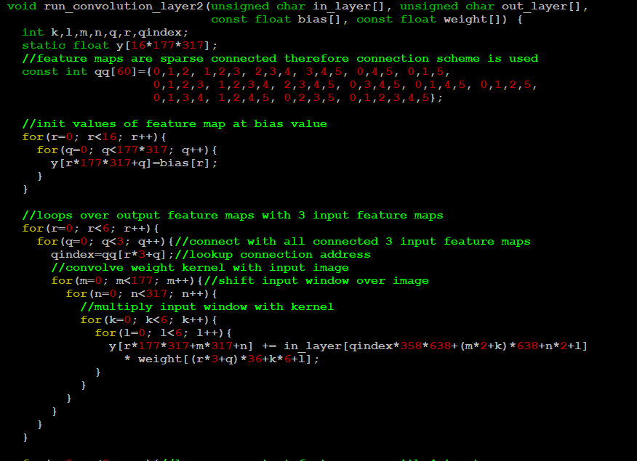
CNN Acceleration
CNN in pure C – Layer_2

Slide 22
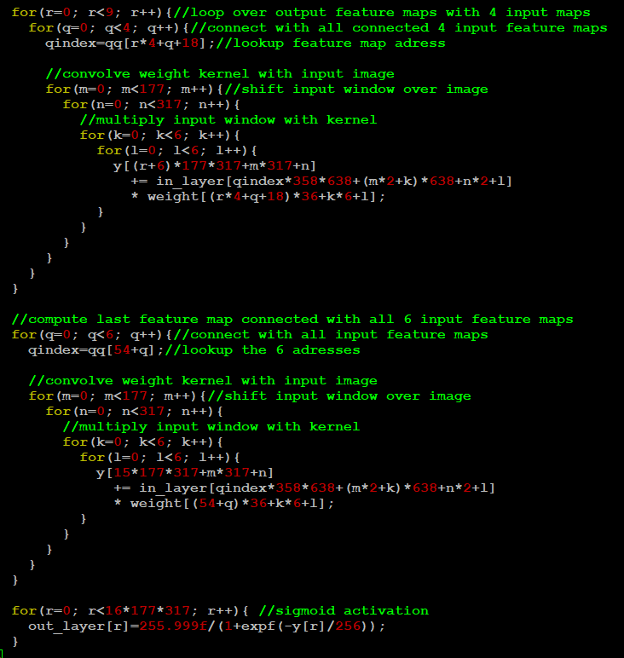
CNN Acceleration
CNN in pure C – Layer_2

Slide 23
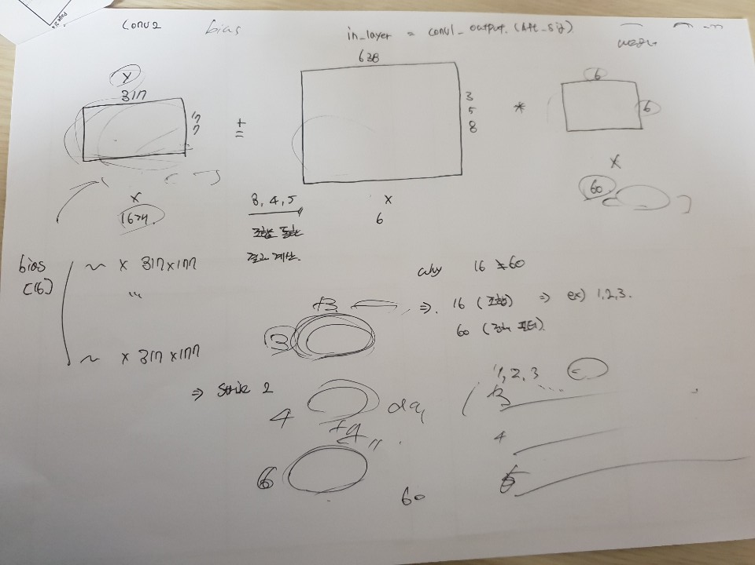
CNN Acceleration
CNN in pure C – Layer_2

Slide 24
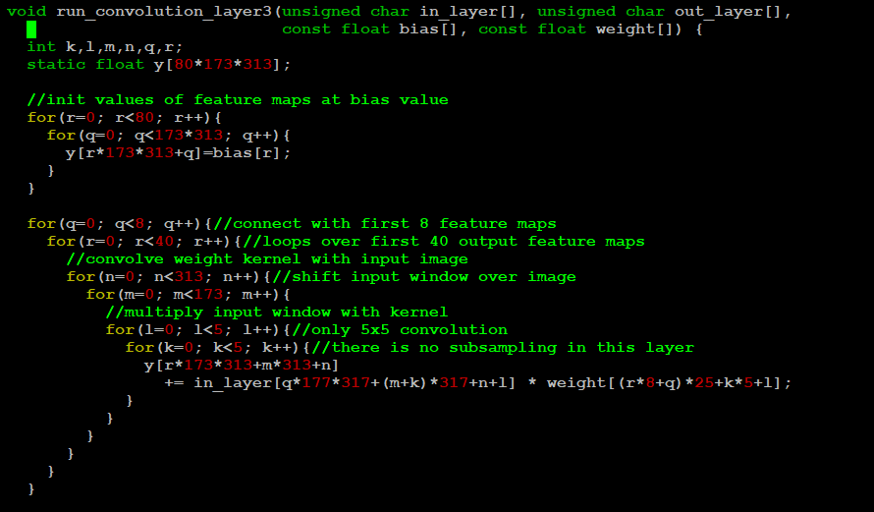
CNN Acceleration
CNN in pure C – Layer_3

Slide 25
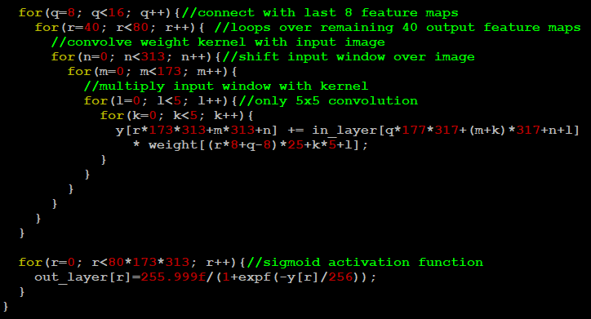
CNN Acceleration
CNN in pure C – Layer_3

Slide 26
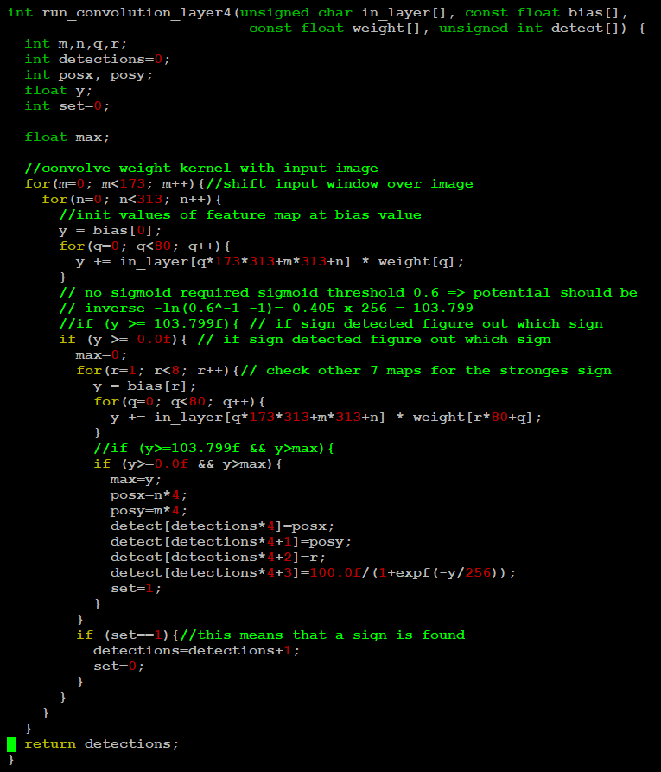
CNN Acceleration
CNN in pure C – Layer_4

Slide 27
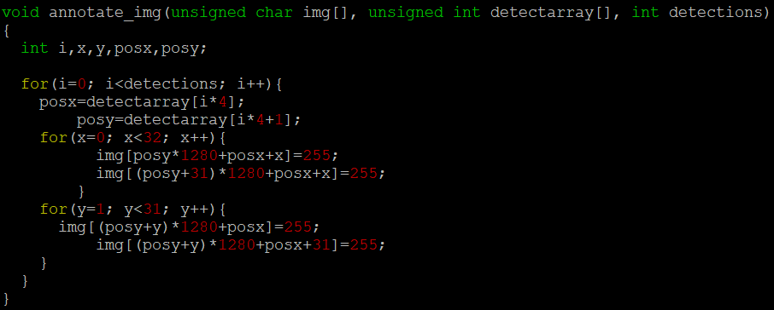
CNN Acceleration
CNN in pure C – Annotation

Slide 28
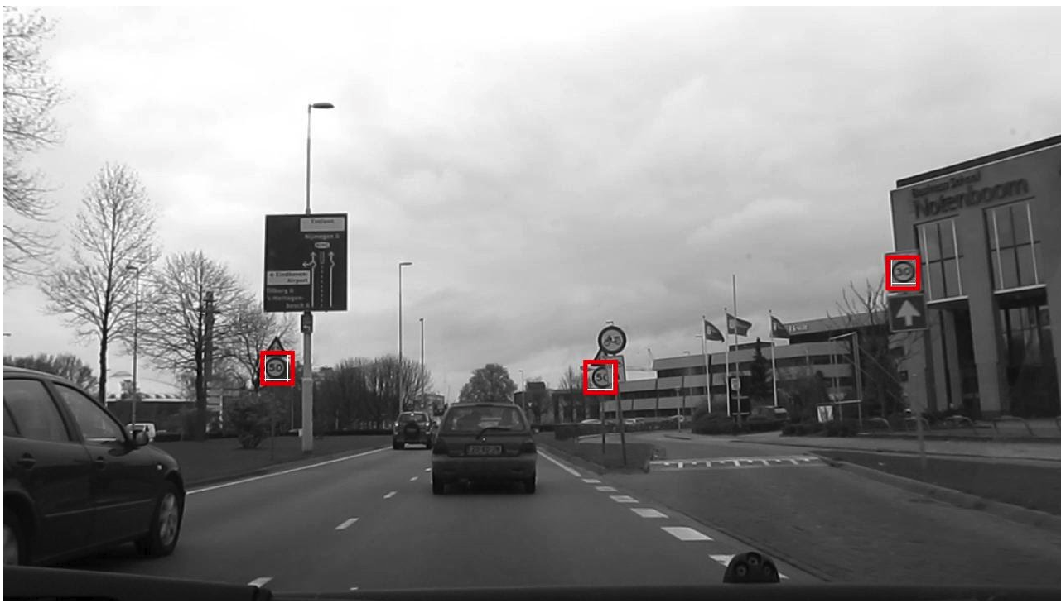
CNN Acceleration
Output Image

Slide 29
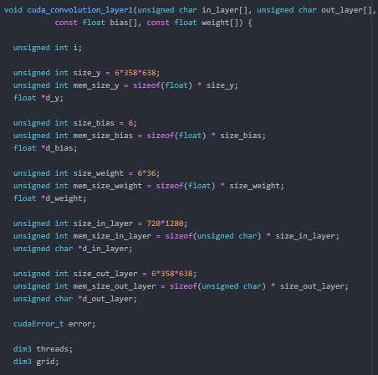
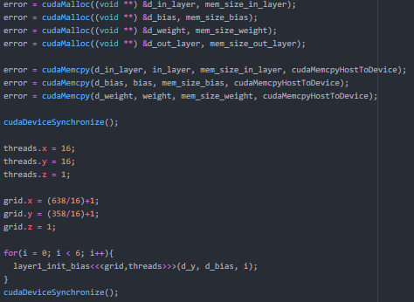
CNN Acceleration
CNN in Cuda – Convolution1

Slide 30
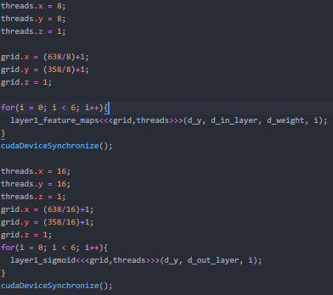
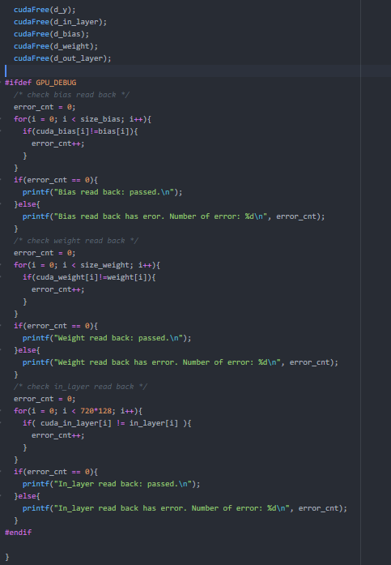
CNN Acceleration
CNN in Cuda – Convolution1

Slide 31
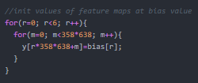

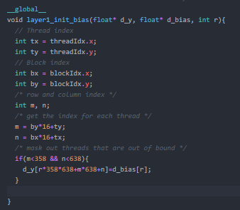
CNN Acceleration
CNN in Cuda – Convolution1 – init_bias

Slide 32
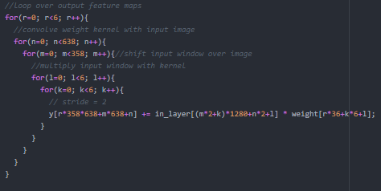
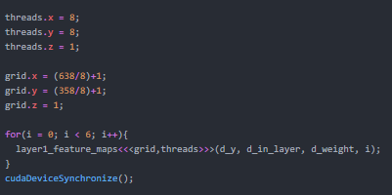
CNN Acceleration
CNN in Cuda – Convolution1 – conv_feature_map

Slide 33
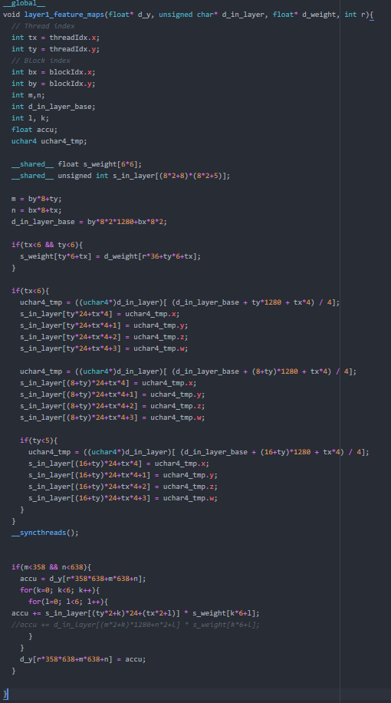
CNN Acceleration
CNN in Cuda – Convolution1 – conv_feature_map

Slide 34
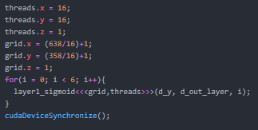

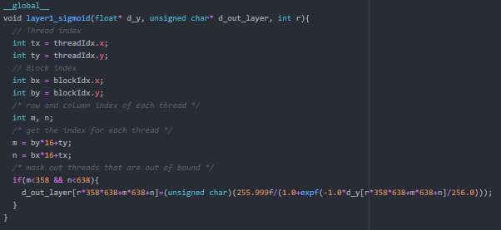
CNN Acceleration
CNN in Cuda – Convolution1 – init_bias

